Slide 1
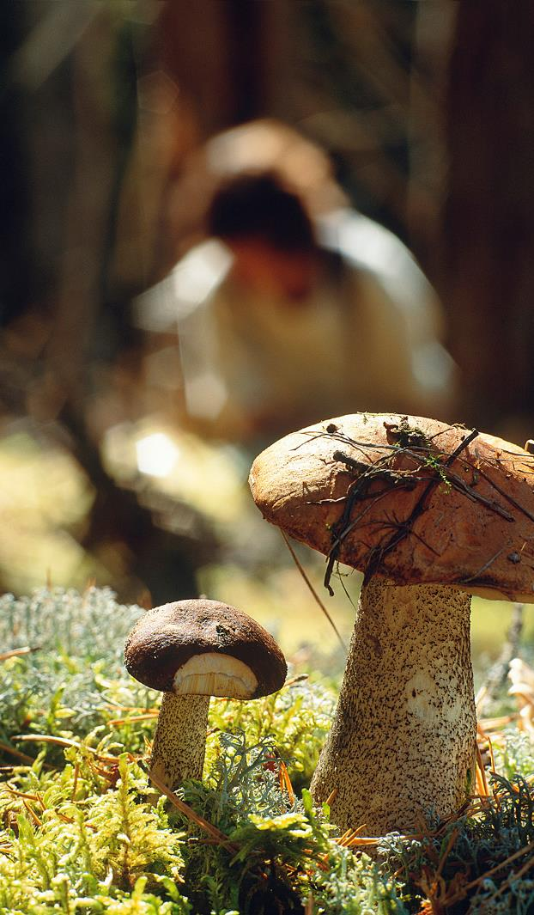
Promotion of biodiversity
- beyond risk reduction in government funded projects
STOCKHOLM 5 MAJ
Björn Johansson

Slide 2
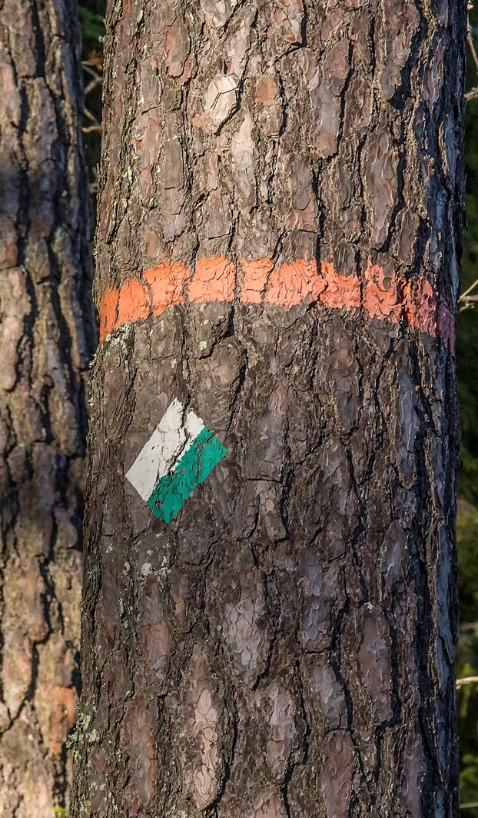
Drivers and instruments
Environmental Quality Objectives
  A non-toxic environment
The Environmental Code
  Polluter pays principle
  Etc
Government funding according to ordinance
  approx. 900 million SEK (~90 million euros) annually
Notes:
Main objective of remediation is to reach a non-toxic environment where contaminated sites do not pose a threat to human health or the environment.
However, this target facilitates and is instrumental to achieve several other targets.
A rich fauna and flora
Living lakes and watercourses
Groundwater of good quality
A rich agricultural landscape
Main principle – PPP (operator or property owner)
Where know responsible party exists or can be held liable, government funding is available.
Previously the grant has been used to certain nature restorations connected to remedial actions

Slide 3
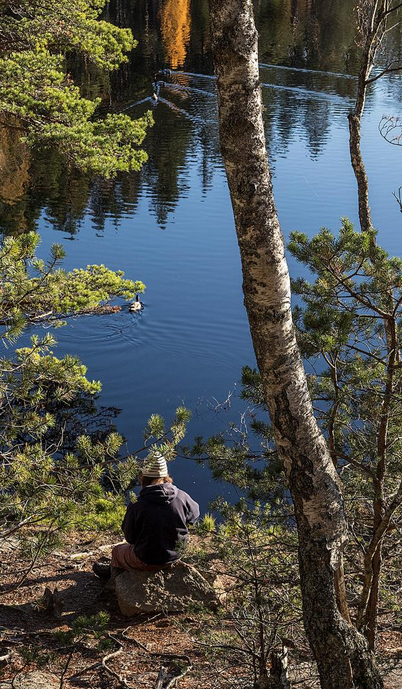
Audit by EU Commission
Audit in relation to regulation of state aids (GBER)
More strict interpretation of the ordinance governing state funding (2004:100)
  Only contaminant- and riskreduction
  Very limited room for restoration of natural and cultural heritage values
New ordinances as of April 2022
  State grants
    Certain restorations beyond contaminant- and riskreduction
  State aid

Slide 4
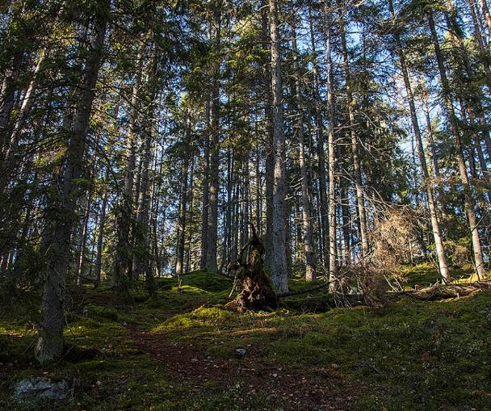
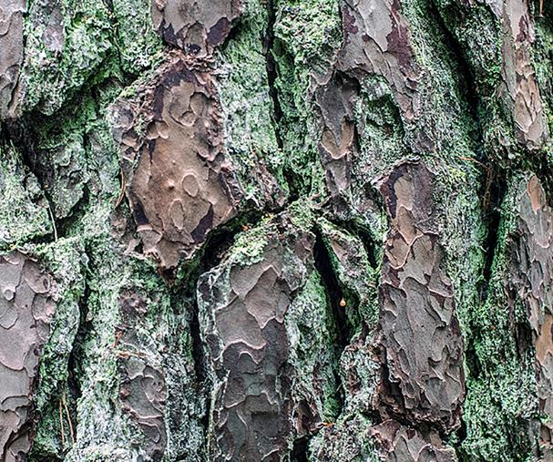
State grants
Grants may be given for:
…
7. Actions that are required in order to preserve or restore natural or cultural values related to remedial actions.
(Provided certain conditions)
Using state grants for remediation we aim to create:
- Cost effective levers for added values
- Enhanced recovery of ecosystems
Contribute to more environmental quality objectives and SDGs
STATE AID – still limited possibilities
  Possibly better, coming new regulation
Notes:
Grants are given when the property owner is not an economic operation. For example a municipality
An oportunity to use remedial actions as a lever to create added values for nature and cultural hertitage with limited resources.
Stimulate recovery of ecosystems, by not only mitigate risks but also improve other conditions

Slide 5
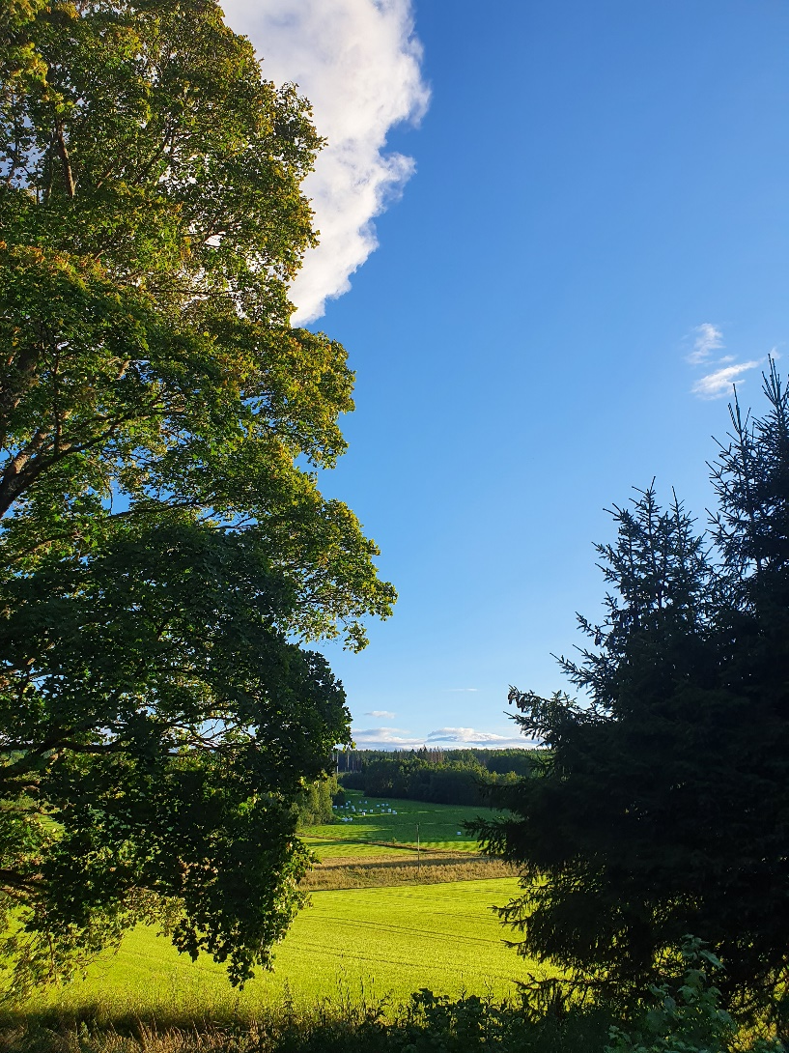
2022 – Project for guidance and financing
Provide:
Guidance on preservation and restoration
Financing of reasonable restorations for enhanced recovery of ecosystems
Preservation of cultural heritage

