Slide 1
Implementation of the SRA: SOILveR network
Esther GOIDTS, Public Administration of Wallonia (SPW) – SOILveR member
May 22, 2019

Slide 2
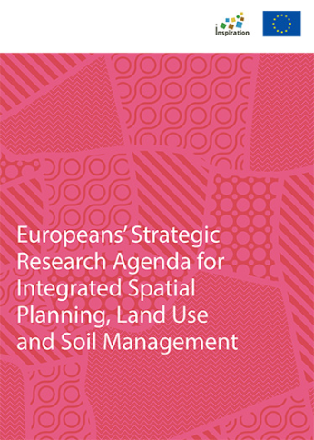
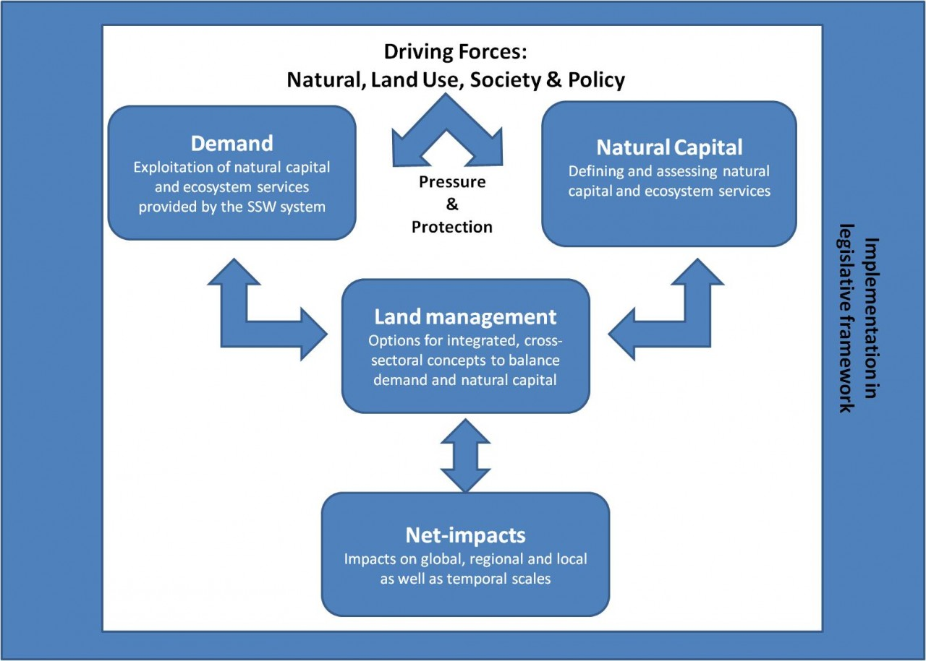

Slide 3
Implementation

Slide 4
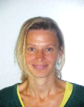
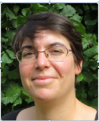
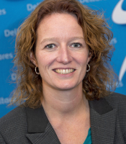
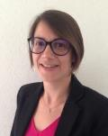
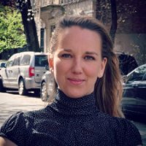
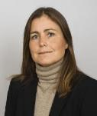
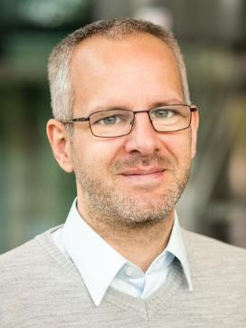
Nele Bal (funder)
OVAM
Public Waste Agency of Flanders
Esther Goidts (funder)
SPW
Service Public de Wallonie
Linda Maring (facilitator)
Deltares
Frédérique Cadiere & Isabelle Feix (funders)
ADEME
French Environment and Energy Management Agency
Eline Toes (funder)
Ministry of Infrastructure and Water management
Yvonne Ohlsson (facilitator)
SGI Swedish Geotechnical Institute
Stephan Bartke (facilitator)
UBA
An initiative by former SNOWMAN members and some partners from the H2020 INSPIRATION project

Slide 5
Starting Point is a
Strategic Research Agenda.
www.soilver.eu
Strategic Research Agenda

Slide 6
An agenda that is reflecting actual stakeholders’ demands.
www.soilver.eu
Strategic Research Agenda
Stakeholders
Soil and land stakeholder
Funder
Researcher

Slide 7
An self-financed, independent platform for funders, who seek to implement parts of this research agenda.
www.soilver.eu
Strategic Research Agenda
Stakeholders
Soil and land stakeholder
Funder
The SOILveR Platform
Researcher

Slide 8
Participating partners agree on the governance of the platform, e.g. establishment of a Platform Steering Committee, Secretariat, Task Groups and National Networking → long term activity
www.soilver.eu
Strategic Research Agenda
Stakeholders
Platform Steering Committee
Secretariat, Task groups
Soil and land stakeholder
Administration
Dissemination & Communication
Networking
Funder
The SOILveR Platform
Researcher

Slide 9
Participating partners agree on the governance of the platform, e.g. establishment of a Platform Steering Committee, Secretariat, Task Groups and National Networking → long term activity
www.soilver.eu
A membership fee ensures the running of the self-financed platform.
“Full members”
Define strategies, overall direction & coordination of the platform, initiate joint calls.
Support the joint secretariat (Full member will be in the range of 5,000 to 10,000 Euro/year depending on the total number of members in the platform).
Can be also allowed to substitute in-kind contributions (e.g. administrative staff time).
Strategic Research Agenda
Stakeholders
Platform Steering Committee
Secretariat, Task groups
Soil and land stakeholder
Administration
Dissemination & Communication
Networking
Funder
The SOILveR Platform
Researcher

Slide 10
Full members initiate calls, select call topics and determine the budgets they are willing to assign in each call to which they want to participate (+specific associated call costs). → specific call activity
www.soilver.eu
Specific topics & budgets
Projects
results
Strategic Research Agenda
Stakeholders
Platform Steering Committee
Secretariat, Task groups
Soil and land stakeholder
Administration
Dissemination & Communication
Networking
Funder
The SOILveR Platform
Researcher

Slide 11
Implementing a call will follow a simple Call procedure building up on experience of partners of former SNOWMAN network (e.g. existing templates, routines as basis).
www.soilver.eu
Call procedure
Projects
Specific topics & budgets
results
Strategic Research Agenda
Stakeholders
Platform Steering Committee
Secretariat, Task groups
Soil and land stakeholder
Administration
Dissemination & Communication
Networking
Funder
The SOILveR Platform
Researcher

Slide 12
Specific funds and topics can be determined by a limited number of members (full members) …
www.soilver.eu
Call procedure
Projects
Specific topics & budgets
results
Strategic Research Agenda
Stakeholders
Platform Steering Committee
Secretariat, Task groups
Soil and land stakeholder
Administration
Dissemination & Communication
Networking
Funder
The SOILveR Platform
Researcher

Slide 13
Specific funds and topics can be determined by a limited number of members (full members) … and affiliate members can join!
www.soilver.eu
“Affiliate membership”
time-limited and only open for research funds granting organisations or administrations
in order to participate in a dedicated call and its associated costs.
Call procedure
Projects
Specific topics & budgets
results
Strategic Research Agenda
Stakeholders
Platform Steering Committee
Secretariat, Task groups
Soil and land stakeholder
Administration
Dissemination & Communication
Networking
Funder
The SOILveR Platform
Researcher

Slide 14
Each funder – in accordance with domestic regulation – executes contracting and steering of research teams in the projects. Projects shall include different countries.
www.soilver.eu
Contracting / steering
Call procedure
Projects
Specific topics & budgets
results
Strategic Research Agenda
Stakeholders
Platform Steering Committee
Secretariat, Task groups
Soil and land stakeholder
Administration
Dissemination & Communication
Networking
Funder
The SOILveR Platform
Researcher

Slide 15
Periodically updating the research agenda based on emerging gaps and challenges – seeing the INSPIRATION SRA as a starting and living document open to other inputs.
www.soilver.eu
Needs from other initiatives / networks
Contracting / steering
Call procedure
Projects
Specific topics & budgets
results
Strategic Research Agenda
Stakeholders
Platform Steering Committee
Secretariat, Task groups
Soil and land stakeholder
Administration
Dissemination & Communication
Networking
Funder
The SOILveR Platform
Researcher

Slide 16
Get started with a pilot call!
Testing Pilots
ADEME – French environment and Energy management agency (France)
SPW – Public Administration of Wallonia (Belgium)
Ministry Infrastructure and Water Affairs (The Netherlands)
Recognizing and caring for soil and land as assets

Slide 17
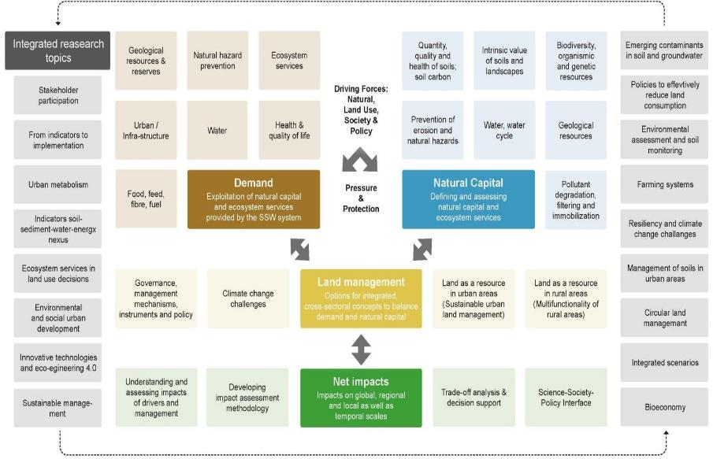
Topic selection
Recognizing and caring for soil and land as assets

Slide 18
Topic selection
Recognizing and caring for soil and land as assets
IRT14 | Emerging contaminants’ in soil and groundwater – ensuring long-term provision of drinking water as well as soil and freshwater ecosystem services
IRT2 | Recognizing the value of ecosystem services in land use decisions
Emerging contaminants in point sources and as diffuse pollution in soil and groundwater
Recognizing the value of soil in land use decision

Slide 19
Partners welcome on board !
Italy?
Romania?
Montenegro?
Germany?
www.soilver.eu
FAQ, Briefing Notes and more to come
info@soilver.eu

Slide 20
Our ambassadors are with you in the rounds of discussion
List of contact

